Slide 1
title
Exploratory Data Analysis on the Film industry

Slide 2
overview
This initiative involves analyzing current box office trends to identify high-performing genres and audience preferences.
It entails developing film concepts based on these insights, investing in quality production and effective marketing, and continuously monitoring performance to adjust strategies for success.

Slide 3
Business problem
Your company wants to enter the movie industry but lacks expertise in film production.
The challenge is to determine which types of films are currently successful at the box office and
how to use this information to make strategic decisions
on film production and marketing to ensure a competitive edge in the market.

Slide 4
Business Understanding
Your company now sees all the big companies creating original video content and they want to get in on the fun.
They have decided to create a new movie studio, but they don’t know anything about creating movies. You are charged with exploring what types of films are currently doing the best at the box office.
You must then translate those findings into actionable insights that the head of your company's new movie studio can use to help decide what type of films to create.

Slide 5
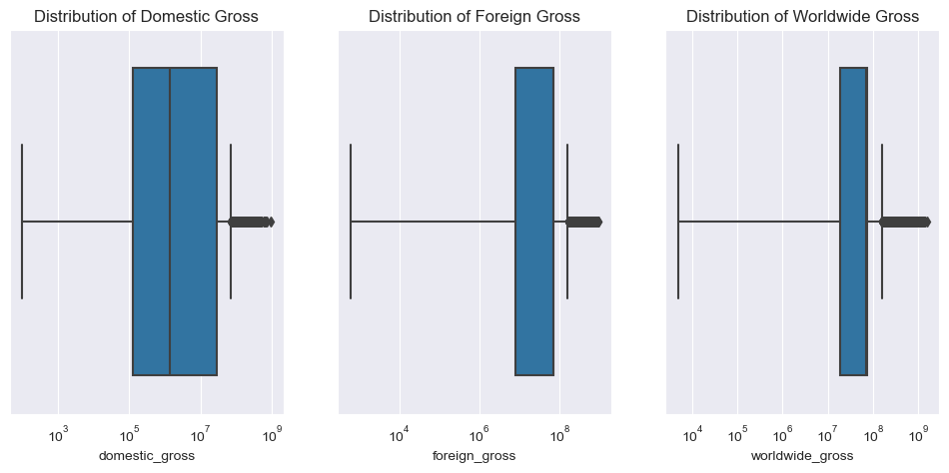
Data analysis

Slide 6
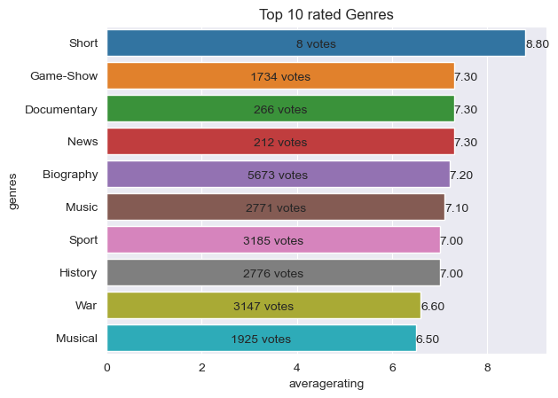
Data Understanding

Slide 7
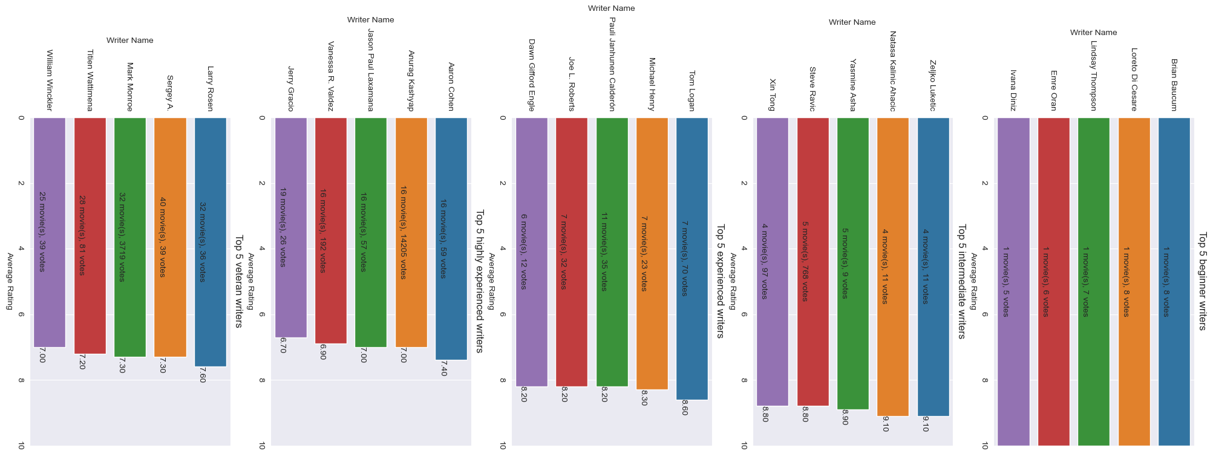
RESULTS

Slide 8
Recommendations
Acquiring talent
- The company has the ability to work with exceptionally skilled writers and directors connected to highly acclaimed movies. The best writers and directors for each experience level have been determined by the analysis. It's crucial to weigh the trade-offs, though, as seasoned experts could have higher expenses despite their potential for success and recognition. Less seasoned workers, on the other hand, might provide new insights and a more affordable option, but they also carry a greater chance of failure.
Gaining knowledge from renowned studios.
-It's critical to imitate the business models of successful studios, like BV Studios, Warner Bros., and Fox Studios. Examine their methods for finding talent, choosing genres, marketing, and distribution in order to implement the best strategies that have continuously led to their success.

Slide 9
Thank YOU!!
NAME: NJERI MBURU

